Slide 1
Social Media Influence and Domestic Election Interference II

Slide 2
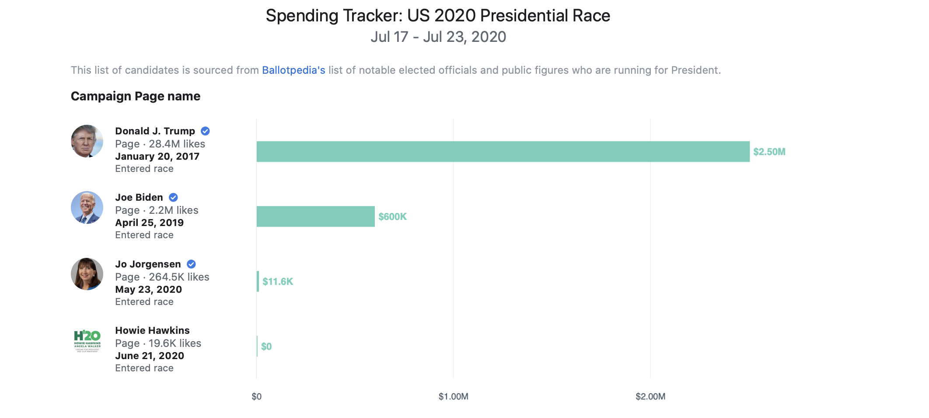
Facebook Ads

Slide 3
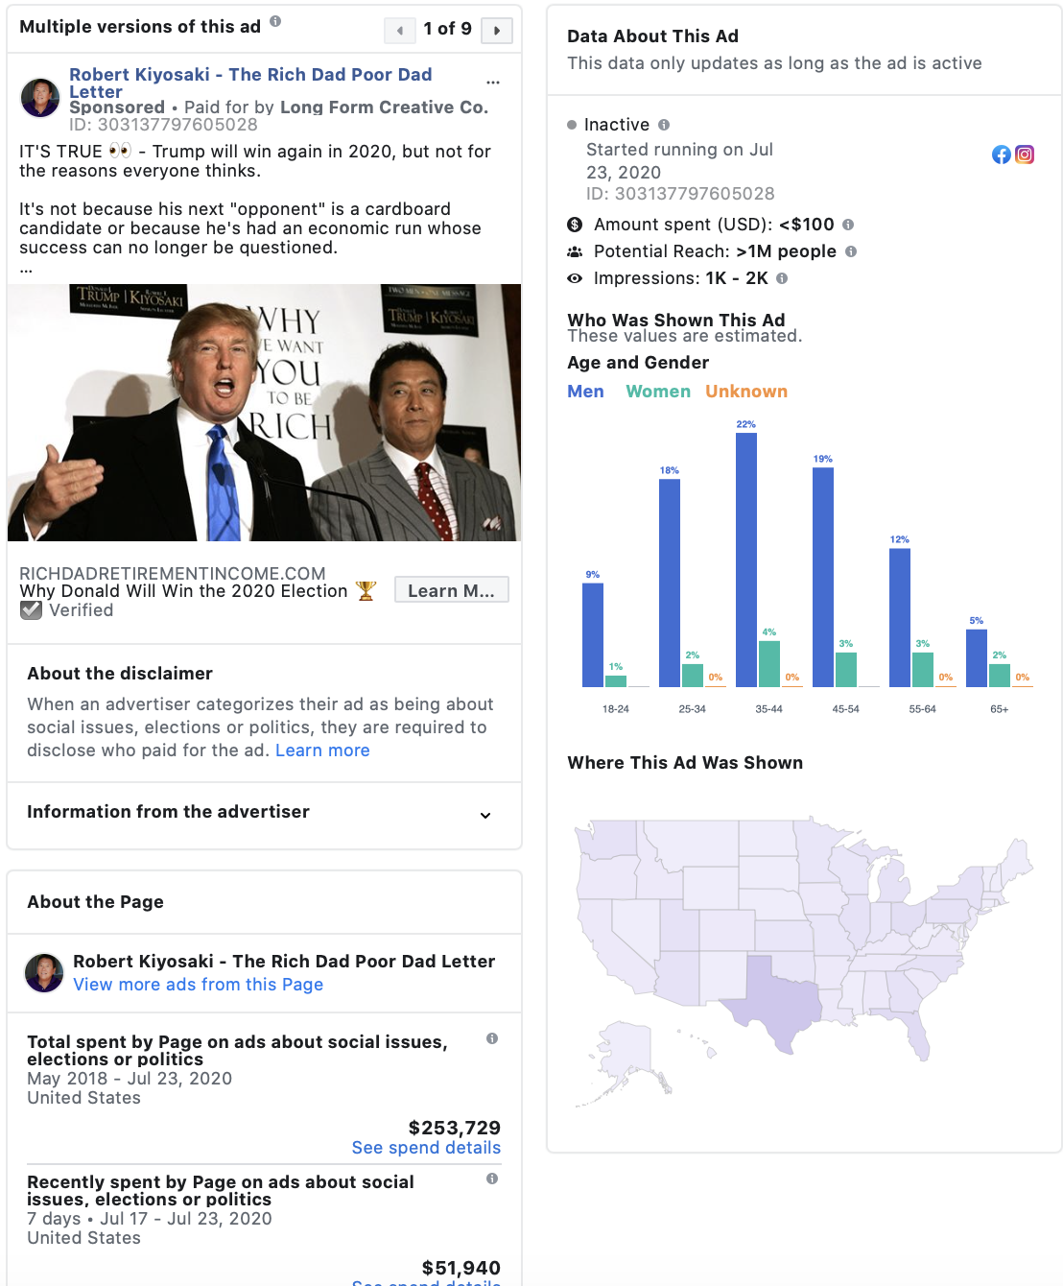
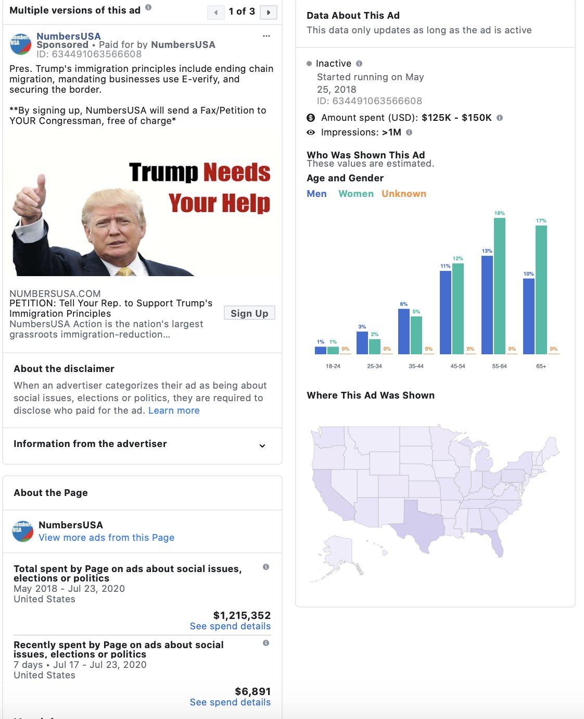
Facebook Ads

Slide 4
SOURCE FOR NEXT CONTENT
What Facebook Did to American Democracy
Source: The Atlantic
Author: Alexis C. Madrigal(Staff writer at The Atlantic and the author of Powering the Dream: The History and Promise of Green Technology)
Date: October 12, 2017
Approximate length: ~3 Pages(“Short”)

Slide 5
What Facebook Did to American Democracy
Chaotic Digital Campaign: Facebook’s enormous distribution power for political information, rapacious partisanship reinforced by distinct media information spheres, the increasing scourge of “viral” hoaxes and other kinds of misinformation.
In June 2014, Harvard Law scholar Jonathan Zittrain wrote an essay in New Republic called, “Facebook Could Decide an Election Without Anyone Ever Finding Out,” in which he called attention to the possibility of Facebook selectively depressing voter turnout. (He also suggested that Facebook be seen as an “information fiduciary,” charged with certain special roles and responsibilities because it controls so much personal data.)
Research shows that a small design change by Facebook could have electoral repercussions, especially with America’s electoral-college format in which a few hotly contested states have a disproportionate impact on the national outcome.
Two thousand kinds of data (or “features” in the industry parlance) get smelted in Facebook’s machine-learning system to make those predictions.
What’s crucial to understand is that, from the system’s perspective, success is correctly predicting what you’ll like, comment on, or share. That’s what matters. People call this “engagement.”
Broader concerns: privacy, surveillance, tech ideology, media-industry competition, or the psychological effects of social media.
“The most serious political problem posed by filter bubbles is that they make it increasingly difficult to have a public argument. As the number of different segments and messages increases, it becomes harder and harder for the campaigns to track who’s saying what to whom...How does a [political] campaign know what its opponent is saying if ads are only targeted to white Jewish men between 28 and 34 who have expressed a fondness for U2 on Facebook and who donated to Barack Obama’s campaign?”
Targeting made tracking the actual messaging that the campaigns were paying for impossible to track. On Facebook, the campaigns could show ads only to the people they targeted. We couldn’t actually see the messages that were actually reaching people in battleground areas. From the outside, it was a technical impossibility to know what ads were running on Facebook, one that the company had fought to keep intact.
In a country where elections can turn on just a couple hundred votes, it's not far-fetched to say that Facebook's efforts to improve voter participation could swing an election, if they haven't already.
Notes:
Domestic election interference

Slide 6
SOURCE FOR NEXT CONTENT
A 61-million-person experiment in social influence and political mobilization
Source: Nature Research Article
Author: Robert M. Bond, Christopher J. Fariss, Jason J. Jones, Adam D. I. Kramer, Cameron Marlow, Jaime E. Settle & James H. Fowler(reseachers and affiliates of UC San Diego and Facebook
Date: September 13th, 2012
Approximate length: ~4 Pages(“Short-Medium”)

Slide 7
A 61-million-person experiment in social influence and political mobilization
Human behaviour is thought to spread through face-to-face social networks, but it is difficult to identify social influence effects in observational studies, and it is unknown whether online social networks operate in the same way.Here we report results from a randomized controlled trial of political mobilization messages delivered to 61 million Facebook users during the 2010 US congressional elections. The results show that the messages directly influenced political self-expression, information seeking and realworld voting behaviour of millions of people. Furthermore, the messages not only influenced the users who received them but also the users’ friends, and friends of friends. The effect of social transmission on real-world voting was greater than the direct effect of the messages themselves, and nearly all the transmission occurred between ‘close friends’ who were more likely to have a face-to-face relationship. These results suggest that strong ties are instrumental for spreading both online and real-world behaviour in human social networks.
Notes:
Domestic election interference

Slide 8
SOURCE FOR NEXT CONTENT
The Billion-Dollar Disinformation Campaign to Re-elect the President
Source: The Atlantic
Author: McKay Coppins(A staff writer at The Atlantic and the author of The Wilderness, a book about the battle over the future of the Republican Party)
Date: February 10th, 2020
Approximate length: ~4 Pages(“Short-Medium”)

Slide 9
The Billion-Dollar Disinformation Campaign to Re-elect the President
Thousands of micro-targeted ads had flooded the internet, portraying Trump as a heroic reformer cracking down on foreign corruption while Democrats plotted a coup. That this narrative bore little resemblance to reality seemed only to accelerate its spread. Right-wing websites amplified every claim. Pro-Trump forums teemed with conspiracy theories. An alternate information ecosystem was taking shape around the biggest news story in the country
Trump and his domestic allies were beginning to adopt the same tactics of information warfare that have kept the world’s demagogues and strongmen in power.
Central to that effort is the campaign’s use of micro-targeting—the process of slicing up the electorate into distinct niches and then appealing to them with precisely tailored digital messages. The advantages of this approach are obvious: An ad that calls for defunding Planned Parenthood might get a mixed response from a large national audience, but serve it directly via Facebook to 800 Roman Catholic women in Dubuque, Iowa, and its reception will be much more positive. If candidates once had to shout their campaign promises from a soapbox, micro-targeting allows them to sidle up to millions of voters and whisper personalized messages in their ear.
In the final days of the 2016 race, for example, Trump’s team tried to suppress turnout among black voters in Florida by slipping ads into their News Feeds that read, “Hillary Thinks African-Americans Are Super Predators.” An unnamed campaign official boasted to Bloomberg Businessweek that it was one of “three major voter suppression operations underway.” (The other two targeted young women and white liberals.)
Candidates, Zuckerberg said, would be allowed to continue running false ads on Facebook. (Commercial advertisers, by contrast, are subject to fact-checking.) In a speech at Georgetown University, the CEO argued that his company shouldn’t be responsible for arbitrating political speech, and that because political ads already receive so much scrutiny, candidates who choose to lie will be held accountable by journalists and watchdogs.
Shady political actors are discovering how easy it is to wage an untraceable whisper campaign by text message.
In 2018, as early voting got under way in Tennessee’s Republican gubernatorial primary, voters began receiving text messages attacking two of the candidates’ conservative credentials. The texts—written in a conversational style, as if they’d been sent from a friend—were unsigned, and people who tried calling the numbers received a busy signal. The local press covered the smear campaign. Law enforcement was notified. But the source of the texts was never discovered.
Notes:
Domestic election interference

Slide 10
Digital Dirty Tricks
Shortly after polls closed in Kentucky’s gubernatorial election last November, an anonymous Twitter user named @Overlordkraken1 announced to his 19 followers that he had “just shredded a box of Republican mail in ballots” in Louisville.
There was little reason to take this claim at face value, and plenty of reason to doubt it (beginning with the fact that he’d misspelled Louisville). But the race was tight, and as incumbent Governor Matt Bevin began to fall behind in the vote total, an army of Twitter bots began spreading the election-rigging claim.
The original post was removed by Twitter, but by then thousands of automated accounts were circulating screenshots of it with the hashtag #StoptheSteal. Popular right-wing internet personalities jumped on the narrative, and soon the Bevin campaign was making noise about unspecified voting “irregularities.” When the race was called for his opponent, the governor refused to concede, and asked for a statewide review of the vote. (No evidence of ballot-shredding was found, and he finally admitted defeat nine days later.)

Slide 11
SOURCE FOR NEXT CONTENT
Social media platforms gird for 78 days of disinformation chaos after Election Day
Source: Roll Call(a newspaper and website published in Washington, D.C., United States, when the United States Congress is in session, reporting news of legislative and political maneuverings on Capitol Hill)
Author: Gopal Ratnam
Date: July 7th, 2020
Approximate length: ~3 Pages(“Short”)

Slide 12
Social media platforms gird for 78 days of disinformation chaos after Election Day
If election results are not known on Election Day, a war of competing narratives on social media could ensue all the way to Inauguration Day
Lawmakers and disinformation experts say social media companies must be prepared to confront the likely onslaught of lies and misleading information during that period.
At Twitter, the company will enforce its rules about fake accounts and disinformation uniformly before and after Election Day, Nick Pickles, the company’s director of public policy strategy, told the House Intelligence Committee. “We’ll take action on foreign actors, and we’ll take action on domestic actors,” he said.
Notes:
Domestic election interference

Slide 13
SOURCE FOR NEXT CONTENT
Do We Really Need To Start Regulating Social Media?
Source: Forbes
Author: Andrew Arnold
Date: June 30th, 2018
Approximate length: ~3 Pages(“Short”)

Slide 14
Do We Really Need To Start Regulating Social Media?
Like anything else, when people begin suggesting that expression and communication be regulated, they often mean “other people’s” communications and expressions.
One of the arguments is that social media empowers large corporations to control the flow of information. As long as they can afford to saturate social media feeds with posts that curate the information they want, anyone standing in opposition to that is essentially steamrolled because they don’t have the resources to counter that.
While there may be reasonable concern about abuse of social media, there’s also reasonable concern that too much regulation could prevent important conversations about topics such abortion, online education and reforms in traditional schools, foreign policy, healthcare, immigration, gun control and emerging firearms technology.
If existing social media platforms aren’t serving the public, isn’t the best solution for someone to disrupt that model? If entrepreneurs are faced with a bunch of regulations limiting their ability to grow and be profitable, something the current batch of social media founders didn’t face, why would they bother?
How will regulation address the notion that people should be accountable for vetting out the sources of information they choose to believe. Can laws really stop people from being gullible? Should they? Who determines when a social media platform has merely provided a free speech platform or when they have intentionally enabled an entity to commit fraud?
Notes:
Domestic election interference

Slide 15
SOURCE FOR NEXT CONTENT
Zuckerberg Hearings Prove Government Shouldn’t Regulate Facebook
Source: Forbes
Author: Andrew Arnold
Date: June 30th, 2018
Approximate length: ~3 Pages(“Short”)

Slide 16
Zuckerberg Hearings Prove Government Shouldn’t Regulate Facebook
If a private entity follows the law, but happens to upset the sensibilities of a power-abusing bully in the United States Senate, they will be punished by with some nannyistic intrusion or byzantine regulation?
The bigger, ideological, problem with the Facebook circus is that our politicians are acting as if being subjected to an opinion — or to an ad — they dislike is some kind of attack on an individual’s rights. Not one senator will ever tell his or her constituents: Hey, if you don’t like the way Facebook conducts itself or you’re unhappy about its political bias or you don’t like that smaller companies also get to target you with content, then leave. No one is forcing you to open or maintain an account with Facebook, much less forcing you to hand over data. And if you’re constantly falling for fake news, well, that’s your problem, because the state can’t fix stupid.
Zuckerberg noted that in five to ten years his company would possess artificial intelligence technology sophisticated enough to eliminate “hate speech” and “fake news” before it was even posted. If Facebook wants to use that technology, it has the right to do so, of course. But many of us who are familiar with the expansive definition of “hate speech” and the people who curate “fake news,” think, well, no thank you.
Notes:
Domestic election interference

Slide 17
SOURCE FOR NEXT CONTENT
Disinformation and the 2020 Election: How the Social Media Industry Should Prepare
Source: NYU Stern Center for Business and Human Rights
Author: Paul Barrett
Date: September 2019
Approximate length: ~28 Pages(Long)

Slide 18
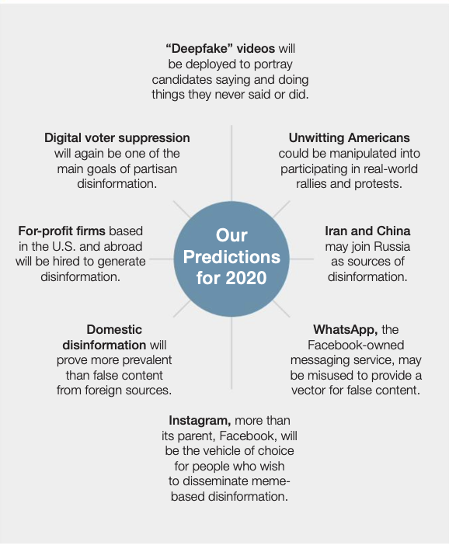

Slide 19
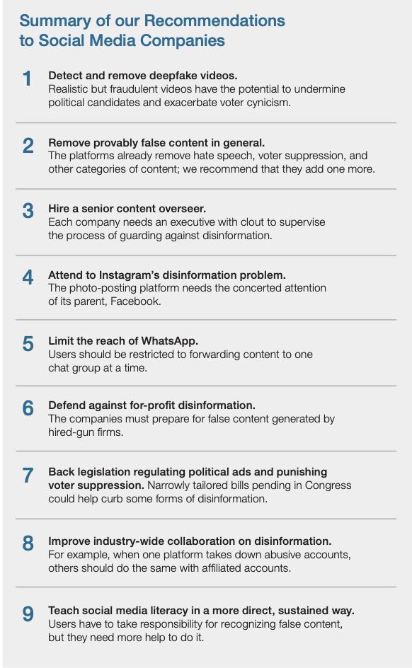

Slide 20
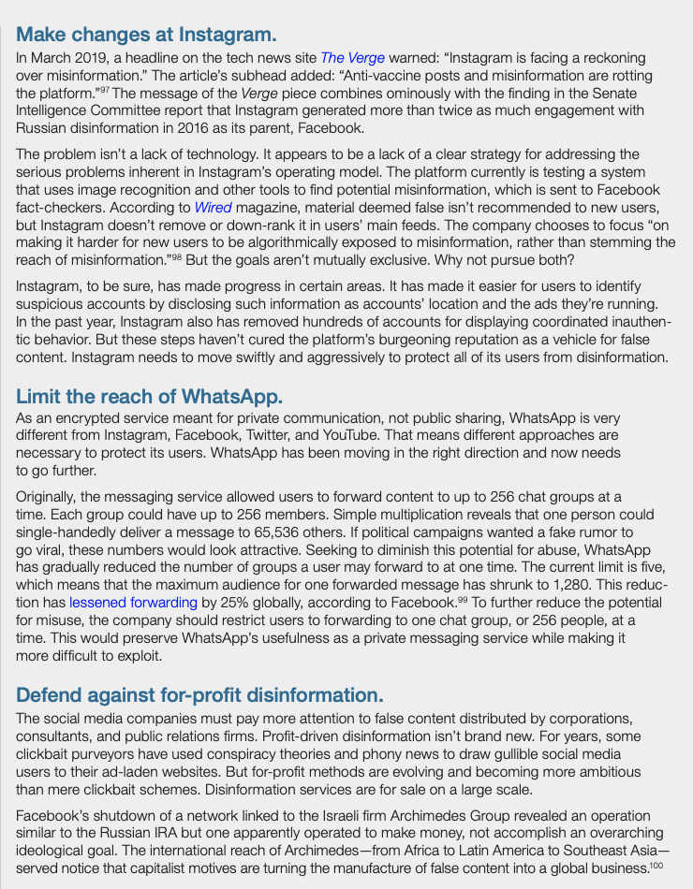

Slide 21
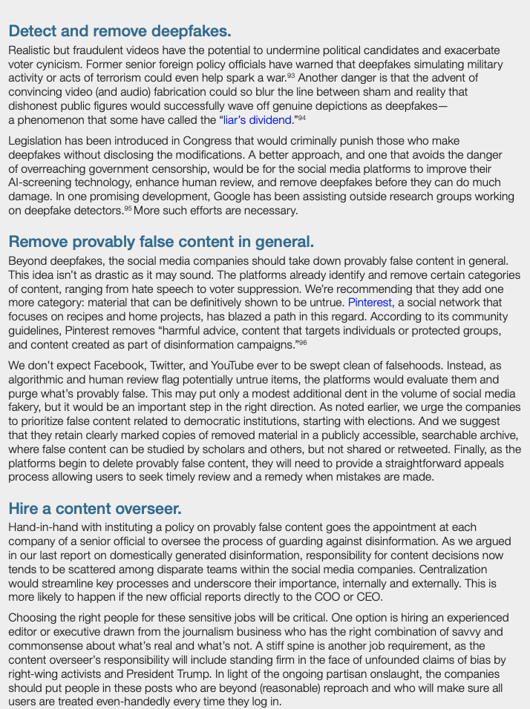

Slide 22
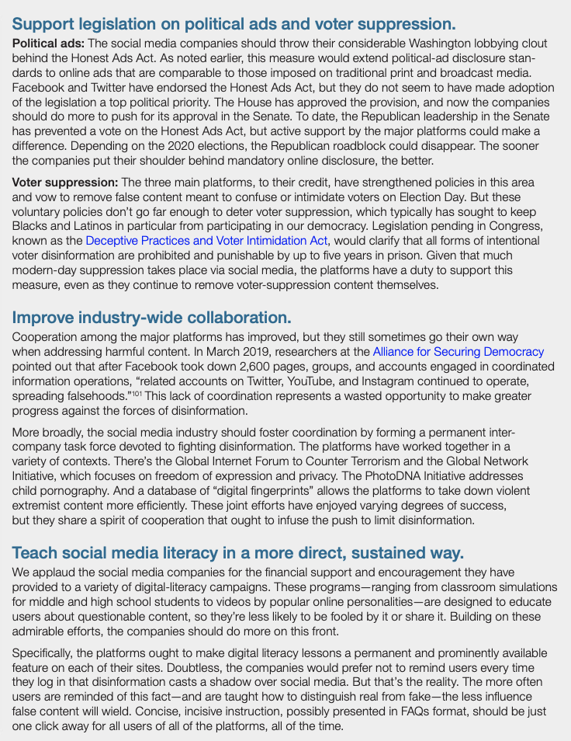

Slide 23
SOURCE FOR NEXT CONTENT
Tackling Domestic Disinformation: What the Social Media Companies Need To Do
Source: NYU Stern Center for Business and Human Rights
Author: Paul Barrett
Date: March 2019
Approximate length: ~28 Pages(“Long”)

Slide 24
Tackling Domestic Disinformation: What the Social Media Companies Need To Do
A growing amount of misleading and false content infests social media. A 2018 study by researchers at Oxford University found that 25 percent of Facebook and Twitter shares related to the midterm elections in the U.S. contained “junk news”— deliberately deceptive or incorrect information. A majority of this harmful content came not from Russia or other foreign state actors but from domestic U.S. sources.
Domestic disinformation comes from disparate sources, including message boards, websites, and networks of accounts on Facebook, Twitter, and YouTube. This homegrown harmful content flows from both liberals and conservatives, but overall, it is predominantly a right-wing phenomenon. Social media researchers have said that highly partisan conservatives are more likely than highly partisan liberals to encounter and share disinformation.
Some commentators have argued that misleading content produced by U.S. citizens is difficult to distinguish from ordinary political communication protected by the First Amendment. According to this view, we shouldn’t encourage the platforms to make judgments about what’s true and untrue in politics.
Facebook, Twitter, and YouTube—which is owned by Google—have historically insisted that they are mere platforms, not responsible for the content they display.

Slide 25
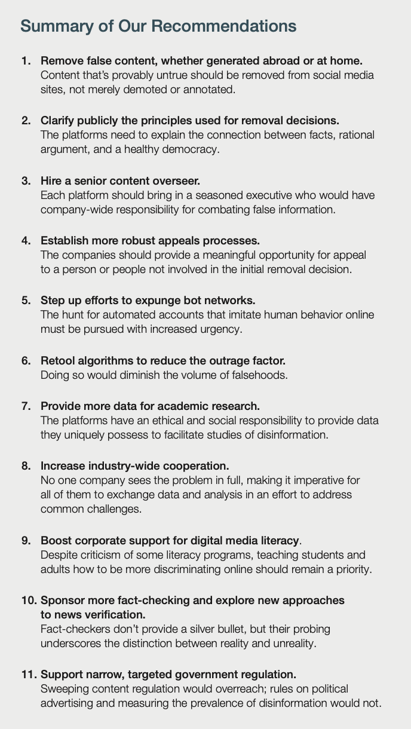

Slide 26
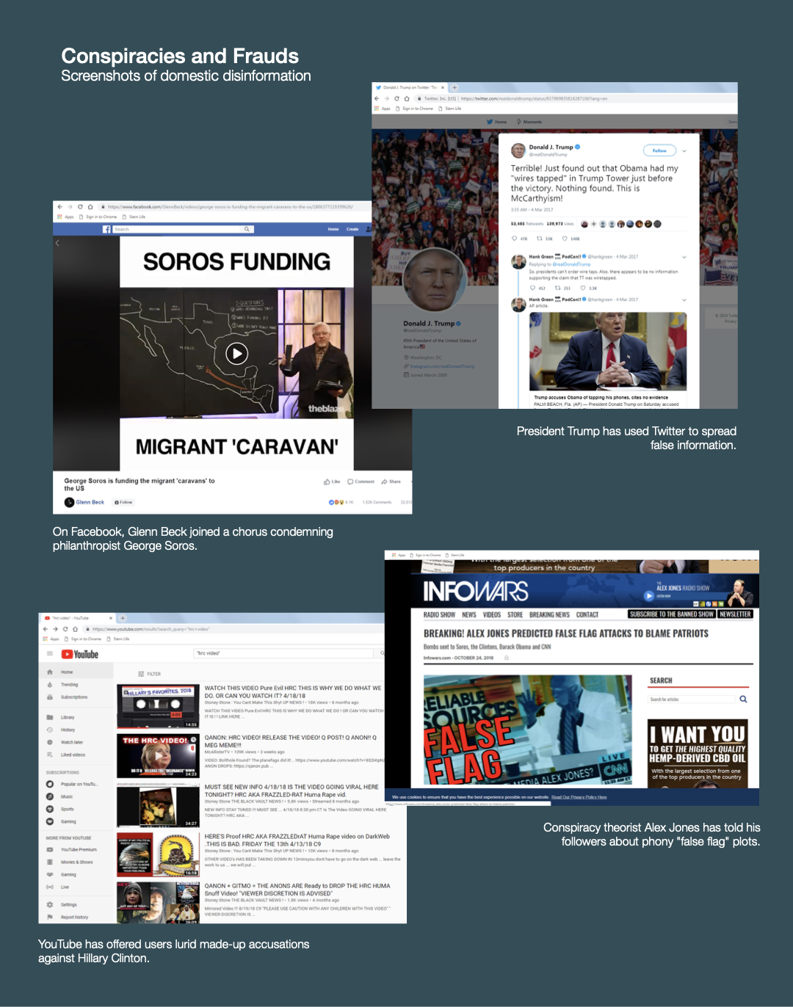

Slide 27
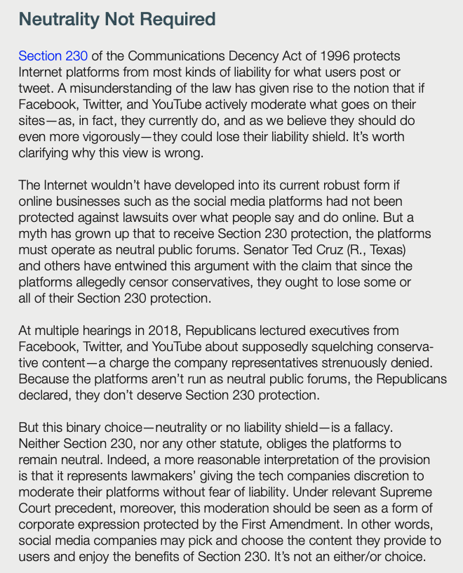

Slide 28
SOURCE FOR NEXT CONTENT
We posed as 100 senators to run ads on Facebook. Facebook approved all of them.
Source: Vice
Author: William Turton
Date: October 30th, 2018
Approximate length: ~3 Pages(“Short”)

Slide 29
We posed as 100 senators to run ads on Facebook. Facebook approved all of them.
On the eve of the 2018 midterms, Facebook's "Paid for by" disclosure for political ads is easily manipulated.
VICE News applied to buy fake ads on behalf of all 100 sitting U.S. senators, including ads “Paid for by” by Mitch McConnell and Chuck Schumer. Facebook’s approvals were bipartisan: All 100 sailed through the system, indicating that just about anyone can buy an ad identified as “Paid for by” by a major U.S. politician.
Facebook confirmed that the 100 "Paid for by" disclosures in the names of U.S. senators should never have been approved. But the company argues that its "Paid for by" feature has brought a new level of transparency to political advertising, and cautioned it's just one piece of its efforts, along with a searchable Ad Archive.

Slide 30
Potential Experts
Ben Nimmo, an information defense fellow at the Atlantic Council’s Digital Forensic Research Lab
David Brody, senior fellow for privacy and technology at the Lawyers’ Committee for Civil Rights Under Law
Nancy Scola, a senior technology reporter for POLITICO Pro.
Ben Scott, director of policy and advocacy at the Omidyar Network.
Paul Barrett, deputy director of New York University’s Stern Center for Business and Human Rights. He wrote this report on Disinformation and the 2020 Election: How the Social Media Industry Should Prepare and this report on Tackling Domestic Disinformation
Nahema Marchal, a researcher at the Oxford Internet Institute’s Computational Propaganda Project.
Lee Foster, who leads the information operations intelligence analysis team at the cybersecurity firm FireEye.
Alexandra S. Levine, a reporter covering the intersection of technology, government and public policy, and she is the author of POLITICO’s popular daily newsletter, Morning Tech.

Slide 31
Graham Brookie, director and managing editor of the Atlantic Council’s Digital Forensic Research Lab, which tracks online disinformation. Served as an adviser on strategic communications in the Obama White House.
Eli Pariser, an author, activist, and entrepreneur focused on how to make technology and media serve democracy. He became executive director of MoveOn.org in 2004, where he helped pioneer the practice of online citizen engagement.
Kevin T. Carroll, a Partner Attorney in Wiggin and Dana’s Litigation Department in the Washington, DC and New York offices. He is also a member of the firm’s cyber security, international trade compliance, and national security practice groups.

Slide 32
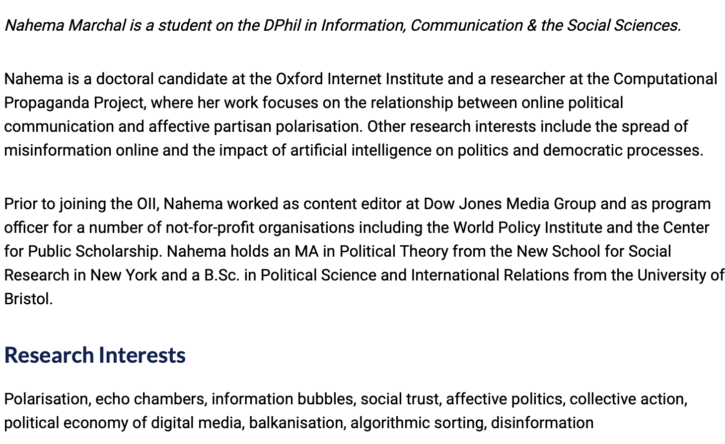

Slide 33
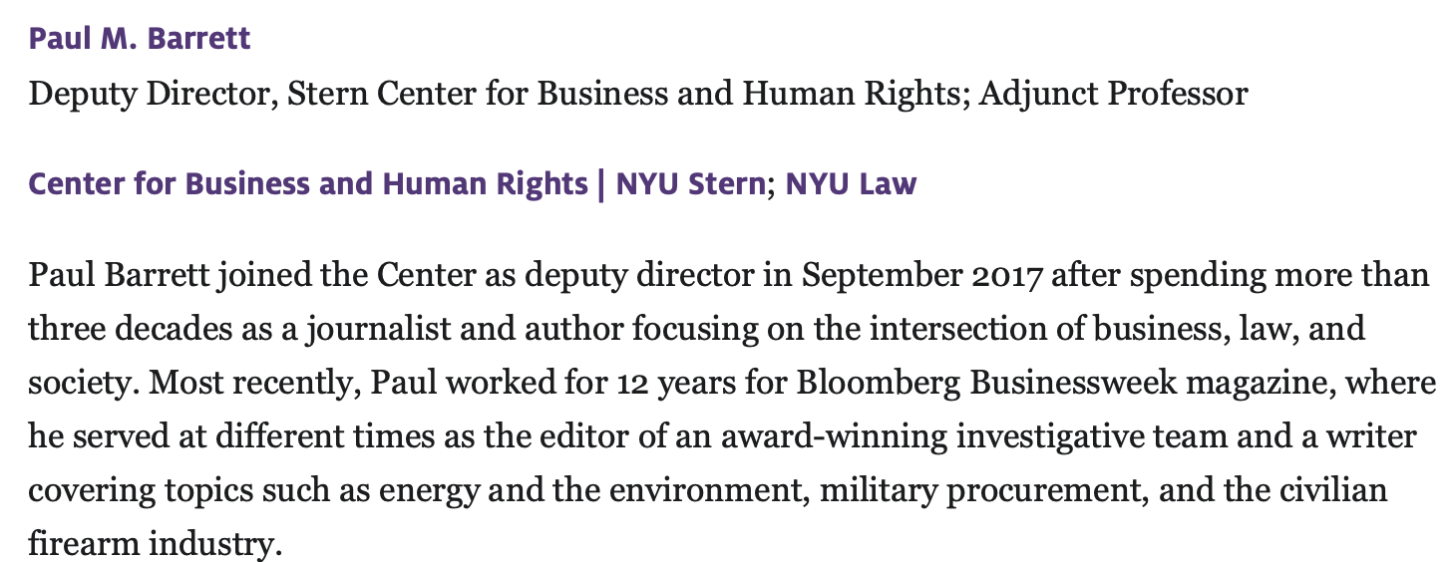

Slide 34
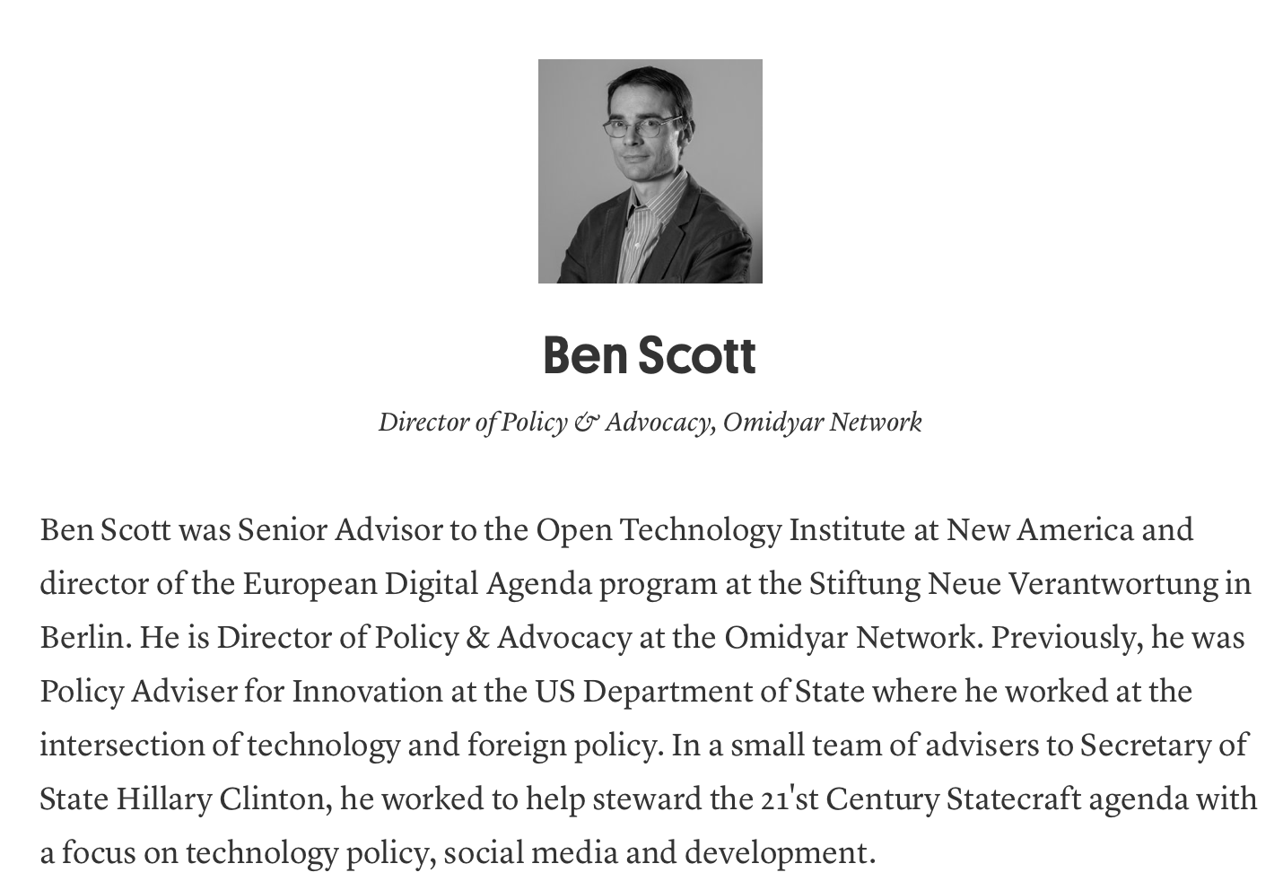

Slide 35
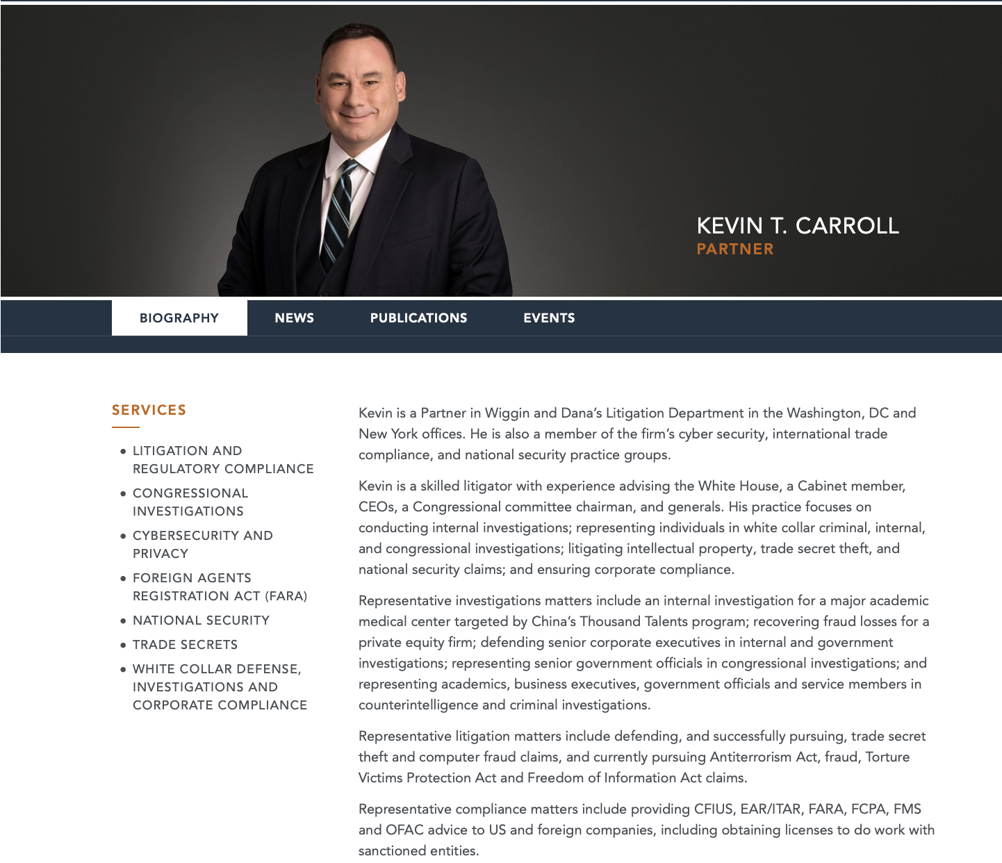

Slide 36
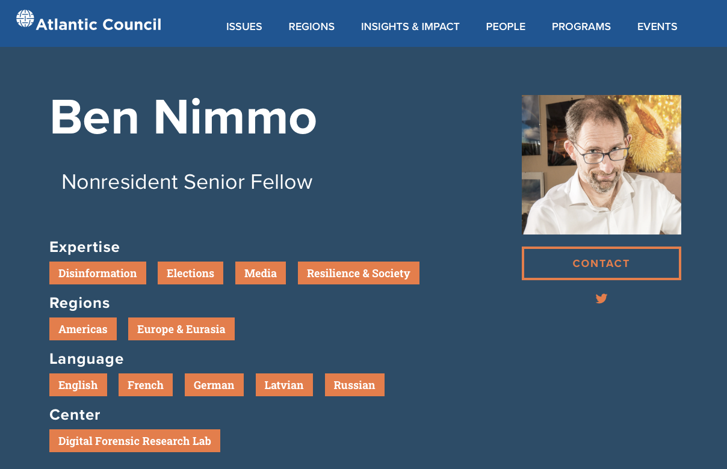

Slide 37
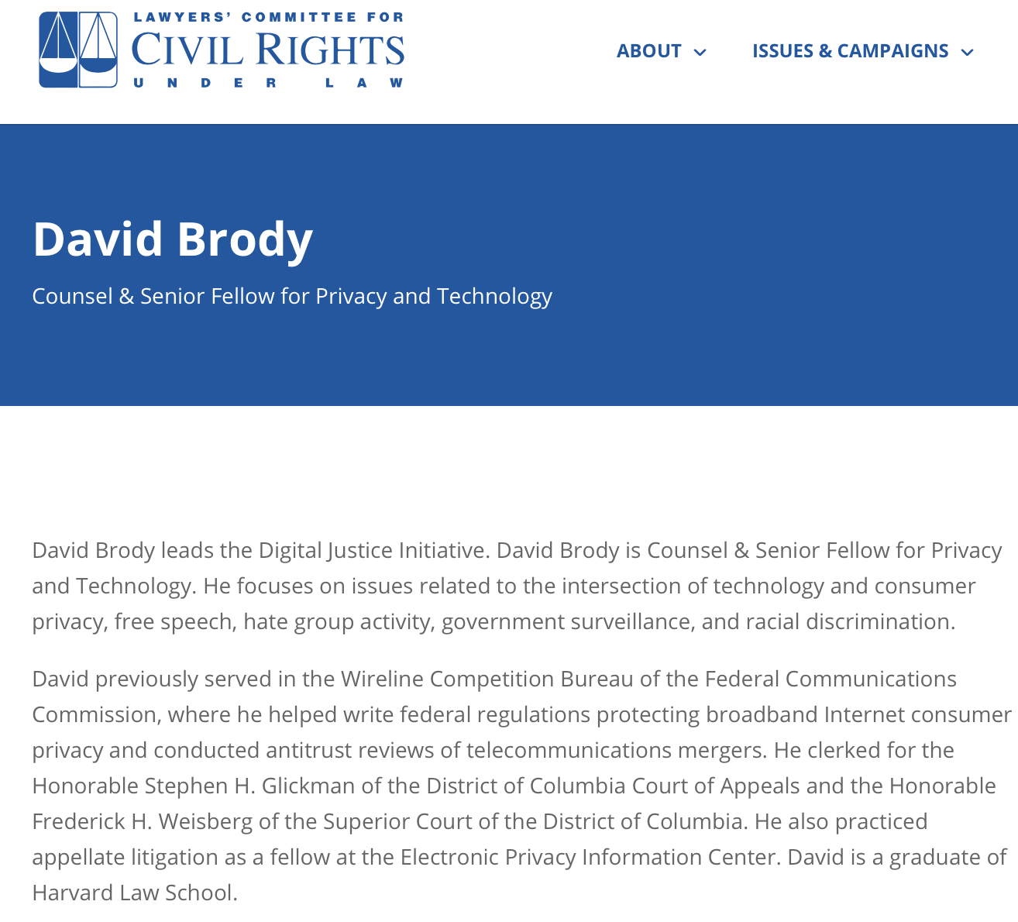

Slide 38
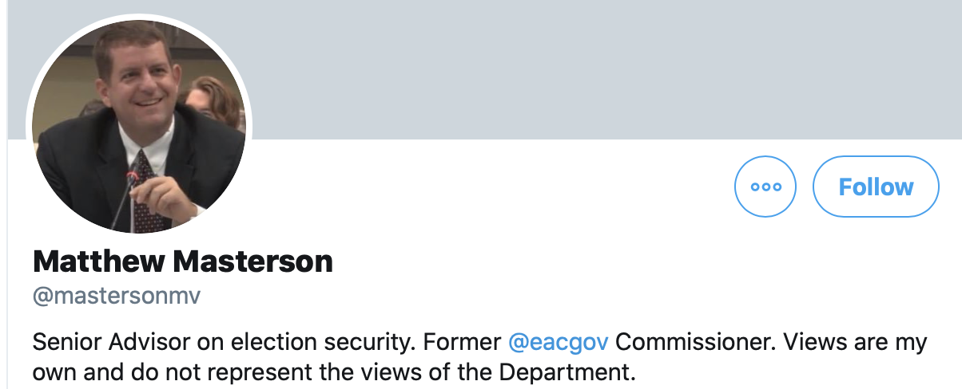

Slide 39
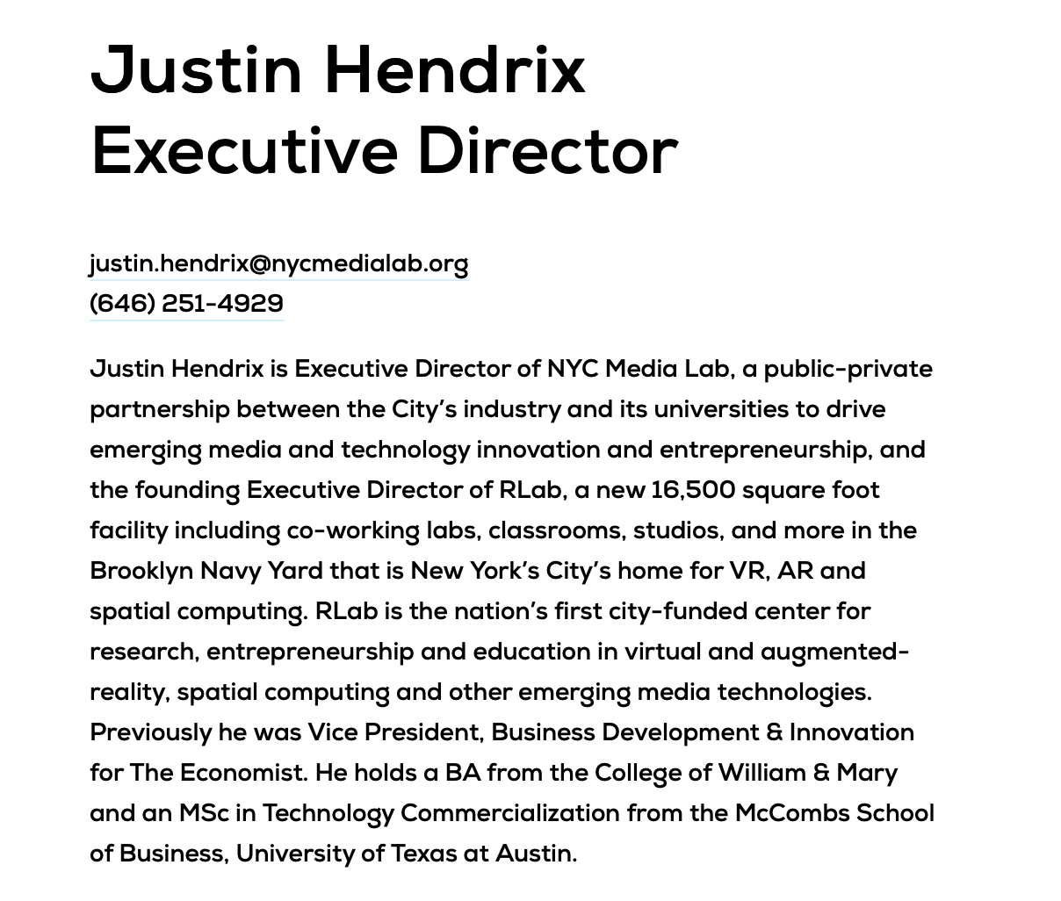

Slide 40
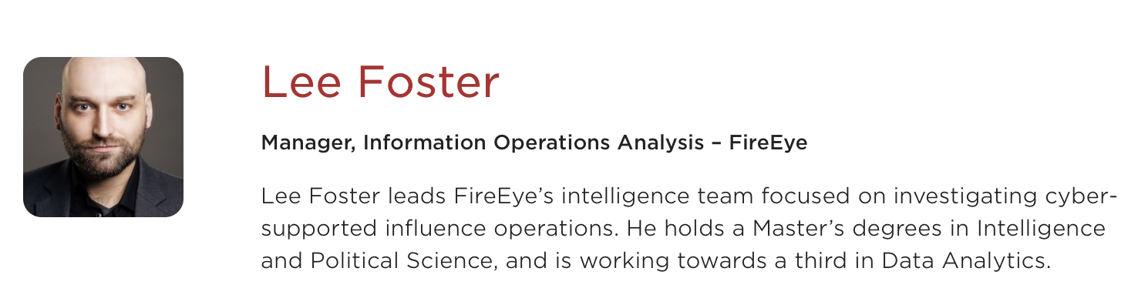

Slide 41
